Slide 1
Online Learning Impact analysis
Submitted in the partial fulfillment for the award of the degree of
BACHELOR OF ENGINEERING
IN COMPUTER SCIENCE WITH SPECIALIZATION IN BIG DATA ANALYTICS
Submitted by:
RAJ SINGH 22BDA70035 ANMOL RANA 22BDA70032 GAUTAM SINGLA 22BDA70030 SIDHARTH PUNDIR 22BDA70006
Under the Supervision of:
DR. AMARDEEP SINGH
Department of AIT-CSE
DISCOVER . LEARN . EMPOWER

Slide 2
Problem Statement & Objectives
Problem Statement
Online learning environments often result in:
Frequent task switching
Short fragmented sessions
Heavy replay dependency
Reduced focus stability
There is no standardized behavioral metric to detect at-risk learners early.
Objectives
Develop Learning Fragmentation Index (LFI)
Develop Replay Dependency Phenomenon (RDP)
Analyze correlation with learning effectiveness
Implement risk classification model
Build interactive Power BI dashboard

Slide 3






Feasibility & Tools
Data Storage
Data Collection
Data Processing & Risk Classification
Google Forms
Google Sheets
Python
Visualization
Pandas
NumPy
Power BI

Slide 4
Budgeting
Feasibility Analysis:
Technical Feasibility: Uses Python, Power BI, Google Forms
Operational Feasibility: Easy to use for students and faculty
Economic Feasibility: Uses mostly free tools
Budget Estimation:
Development Cost: Minimal
Operational Cost: Zero
Maintenance Cost: Very Low
Conclusion: The system is cost-effective and feasible for implementation

Slide 5
Features of Proposed Solution
Identification of Constraints
Behavioral indices: Learning Fragmentation Index (LFI)
Replay Dependency Phenomenon (RDP)
Risk Classification Model (Low, Moderate, High)
Interactive Power BI Dashboard
Early Warning System for identifying at-risk students
Real-time data processing capability
Limited dataset (80 students)
Self-reported data may introduce bias
No real-time LMS integration
Limited project time duration
Basic statistical analysis (no ML models)

Slide 6
Feature Analysis and Finalization
Identification of Standards
Selected Features:
LFI and RDP computation
Risk classification model
Dashboard visualization
Data Standards: CSV format, normalization techniques
Analytical Standards: Pearson correlation, threshold model
Software Standards: Python, Power BI best practices
Ethical Standards: Anonymous data, voluntary participation
Excluded Features:
Machine Learning models
Real-time LMS integration
Custom web application
Reason: Selected features are simple, reliable, and feasible within constraints

Slide 7
Preliminary Results
Data collected from 80 students using Google Forms.
Behavioral indices successfully computed:
Learning Fragmentation Index (LFI)
Replay Dependency Phenomenon (RDP)
Average Values:
LFI = 0.51
RDP = 0.47
Learning Effectiveness = 6.29
Risk Classification:
65% Low Risk
30% Moderate Risk
5% High Risk
Key Observations:
Higher fragmentation leads to lower learning effectiveness
Students with high replay dependency show learning difficulty
LFI and RDP show a positive correlation

Slide 8
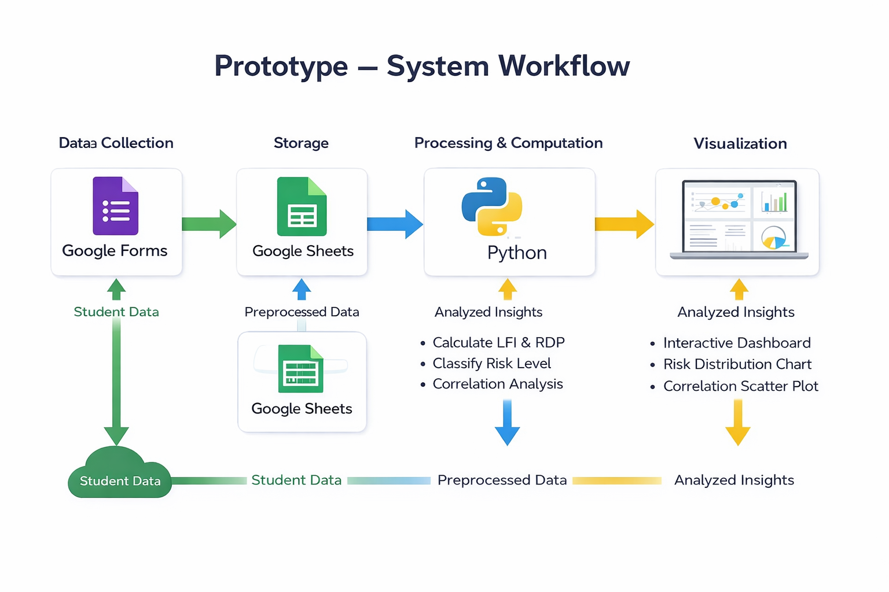
Design Selection/ Prototype
OUTCOMES
System is technically and economically feasible
Design is scalable and efficient
Provides structured approach for implementation
Ready for deployment in academic environments
Design Justification:
Simple and easy to implement
Cost-effective
Scalable for future expansion
Alternative Designs Rejected:
ML-based systems (require large data)
Web-based systems (complex development)

Slide 9
Results & Conclusion
Results Achieved
Developed measurable behavioral indices
Implemented dual-threshold classification
Validated correlation with effectiveness
Created fully functional interactive dashboard
Conclusion
Fragmentation negatively impacts learning
Replay dependency reflects cognitive difficulty
Dual-index model improves risk detection
System can serve as institutional early-warning framework
Thank You

